Slide 1
Voronoi Diagram

Slide 2
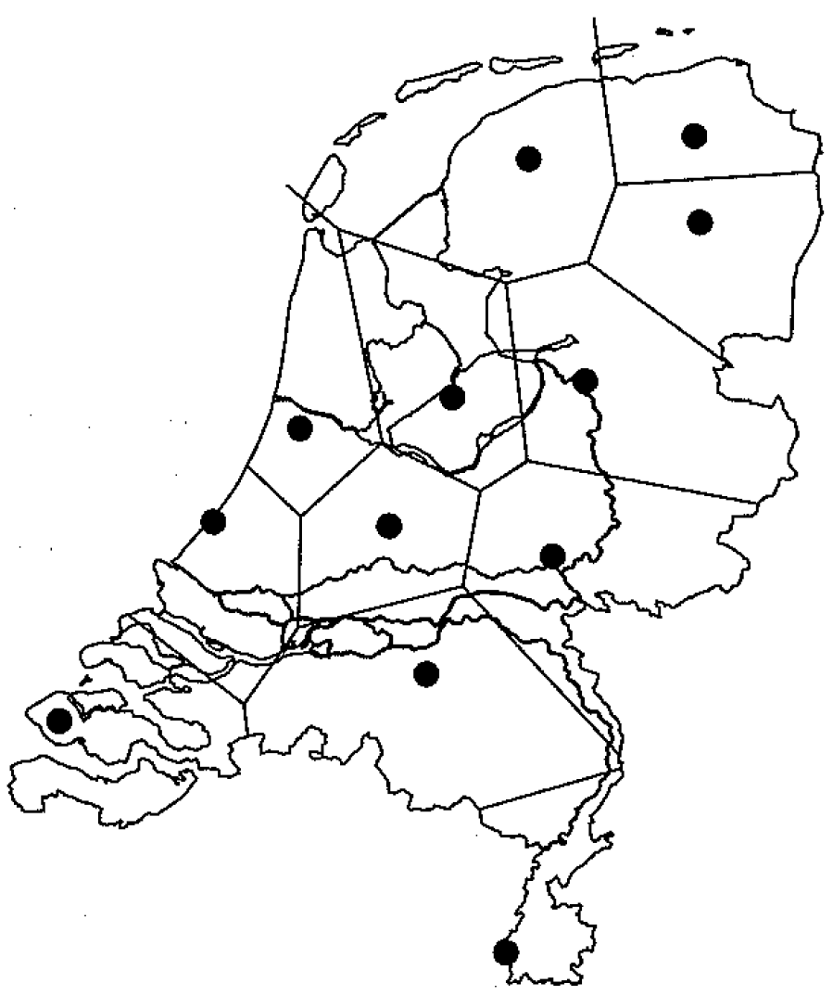
Notes:
Post office problem. Where is the nearest post office?

Slide 3
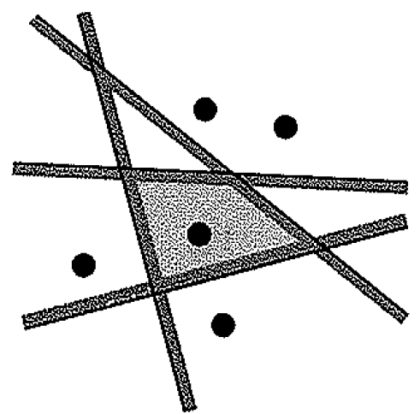
Notes:
Region of points closes to a point is the intersection of halfplanes

Slide 4
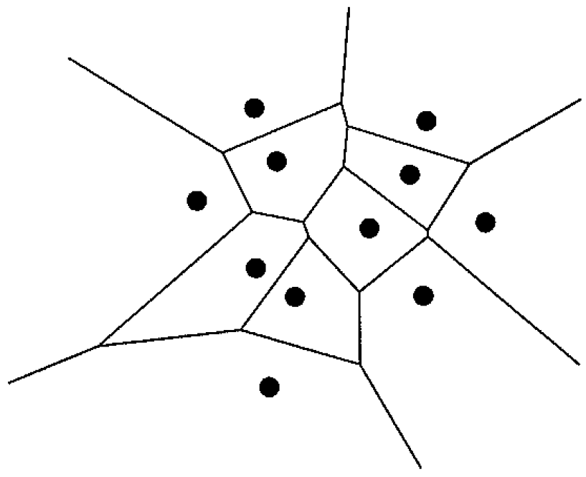

Slide 5
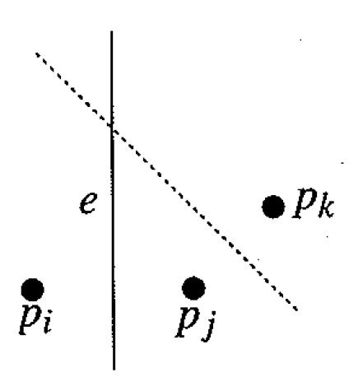
Notes:
Theorem 7.2 – argument that the arrangement is connected

Slide 6
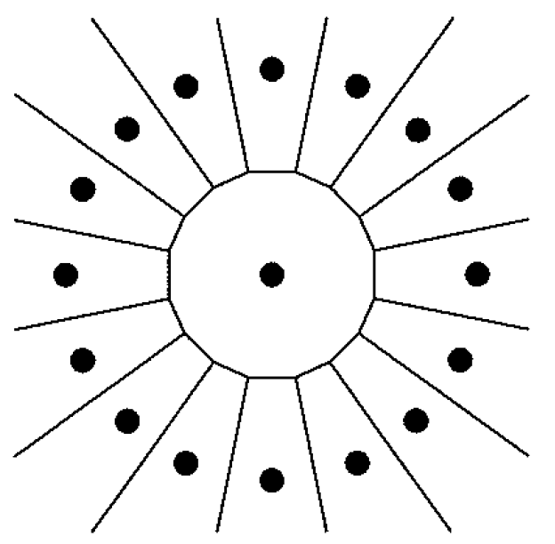
Notes:
Example with many unbounded faces and many infinite half-lines

Slide 7
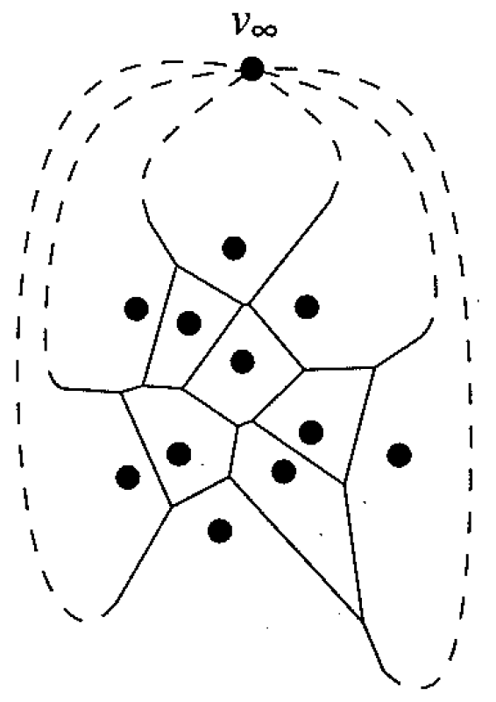
Notes:
Add one vertex, and all line segments are now finite segments bounded by two points

Slide 8
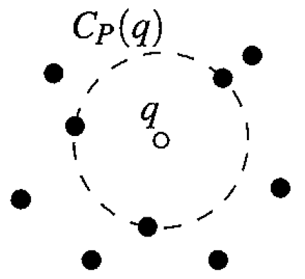
Notes:
A point in the Voronoi Diagram = a point that is the center of a circle with a least 3 points on the boundary

Slide 9
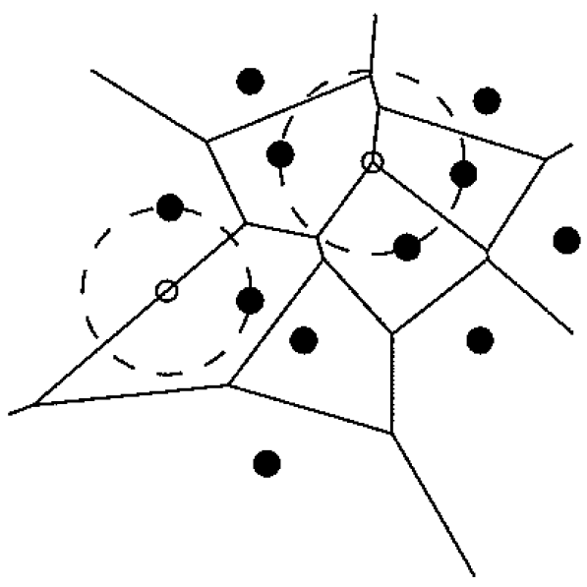
Notes:
Two points on boundary of circe => point is on a line of Voronoi Diagram

Slide 10
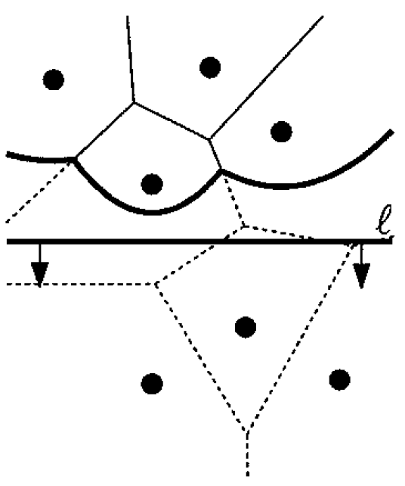
Notes:
Sweepline drawing Voronoi Diagram, Beach Line

Slide 11
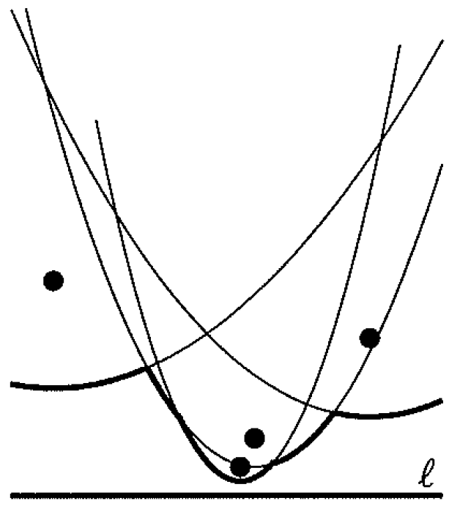
Notes:
Beachline

Slide 12
Notes:
New point on beach line

Slide 13
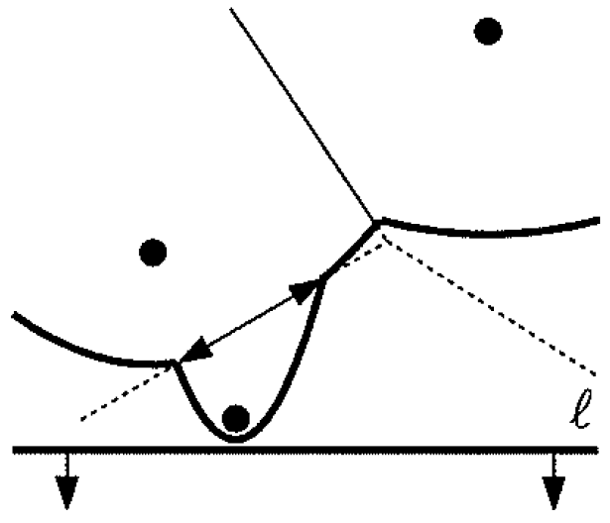
Notes:
A new arc, tracing out a new edge of the Voronoi Diagram

Slide 14
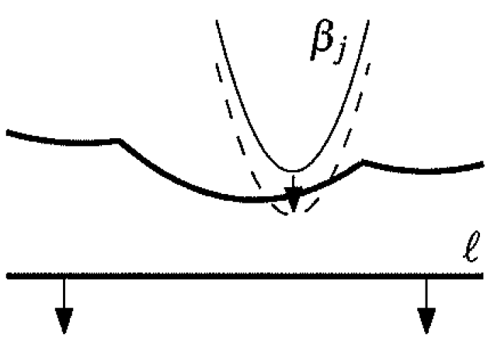
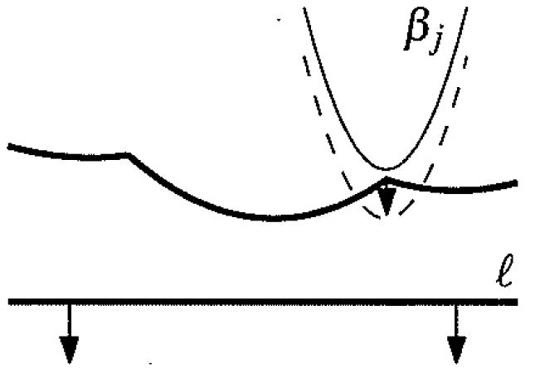
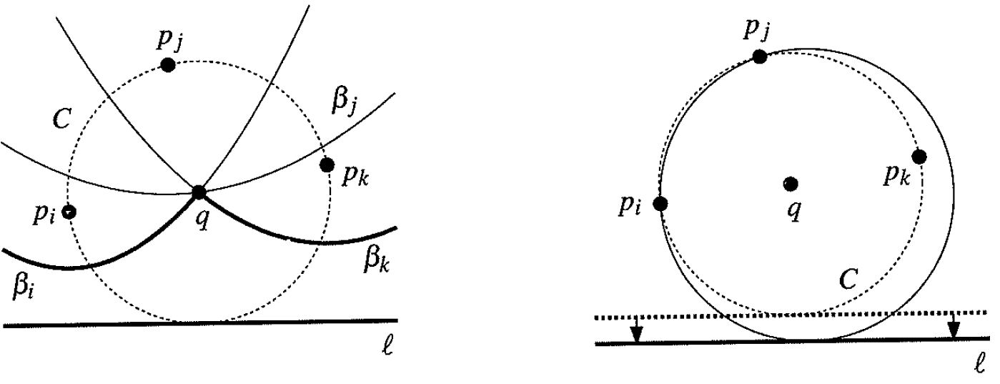
Notes:
Proof of Lemma 7.6 – New arcs only appear through event points

Slide 15
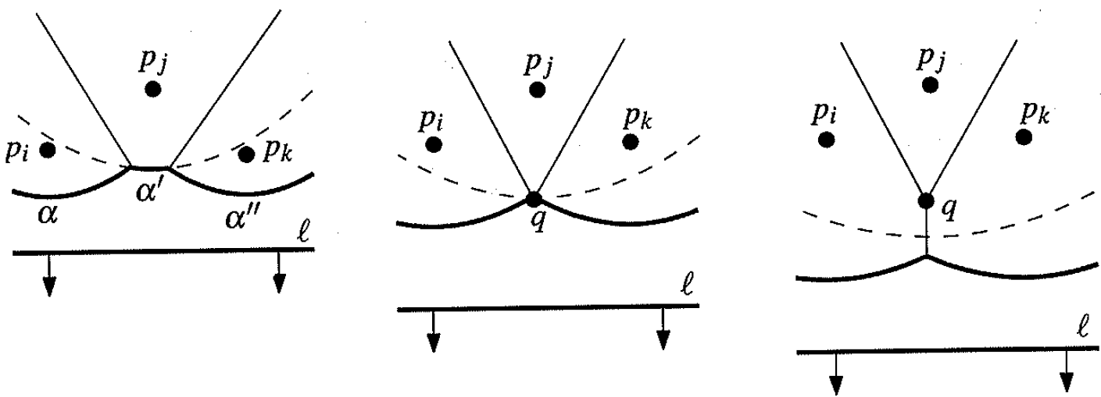
Notes:
An arch disapears from beach line

Slide 16
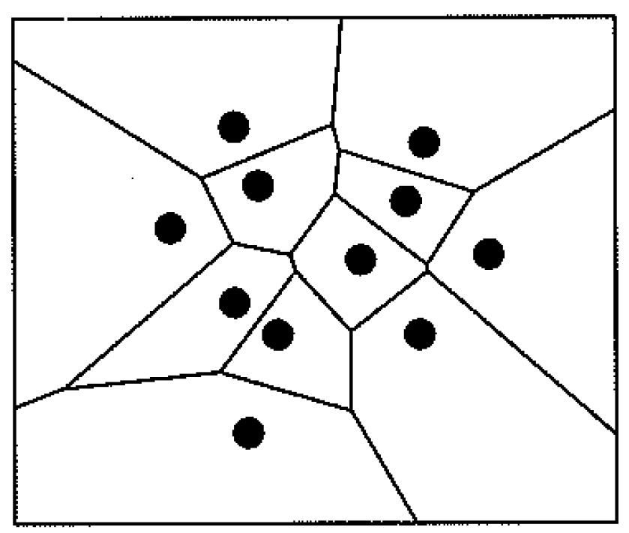
Notes:
Add bounding box at end, to make all segments finate.

Slide 17
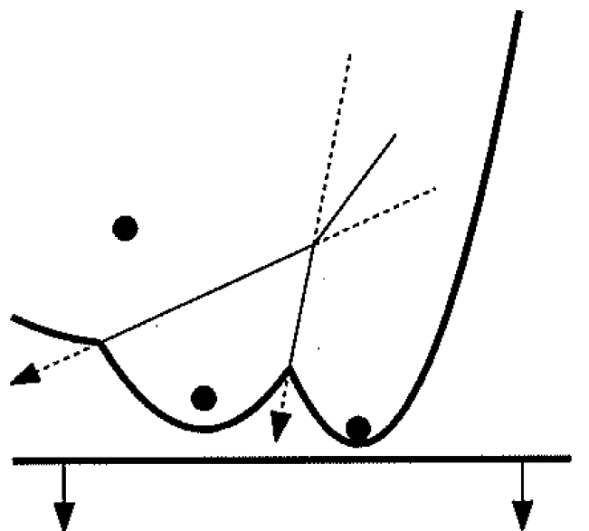
Notes:
Triple of arcs, where the two drawn Voronoi lines diverge, ie middle arc never disappears

Slide 18
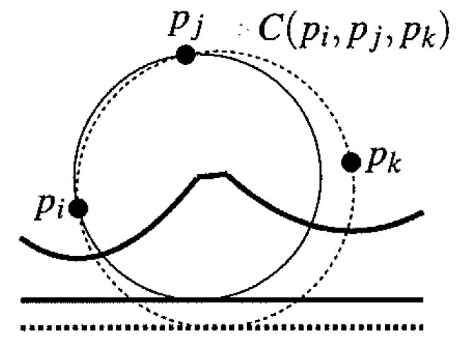
Notes:
Circle event

Slide 19
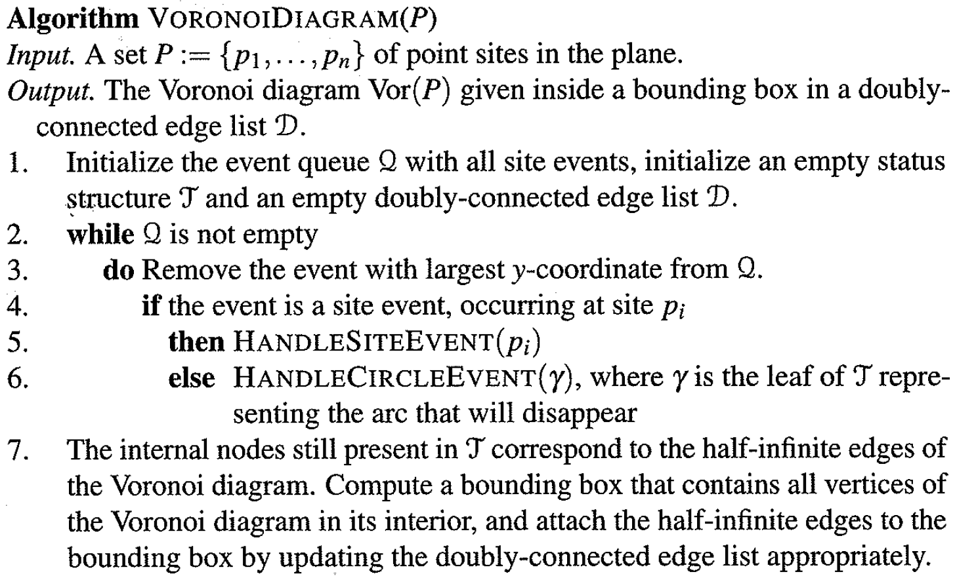

Slide 20
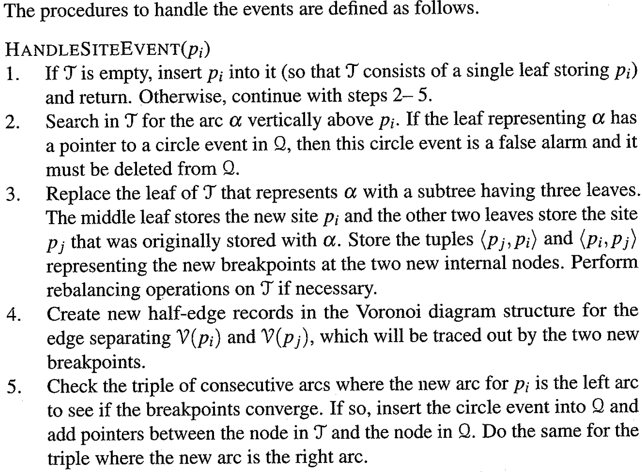

Slide 21
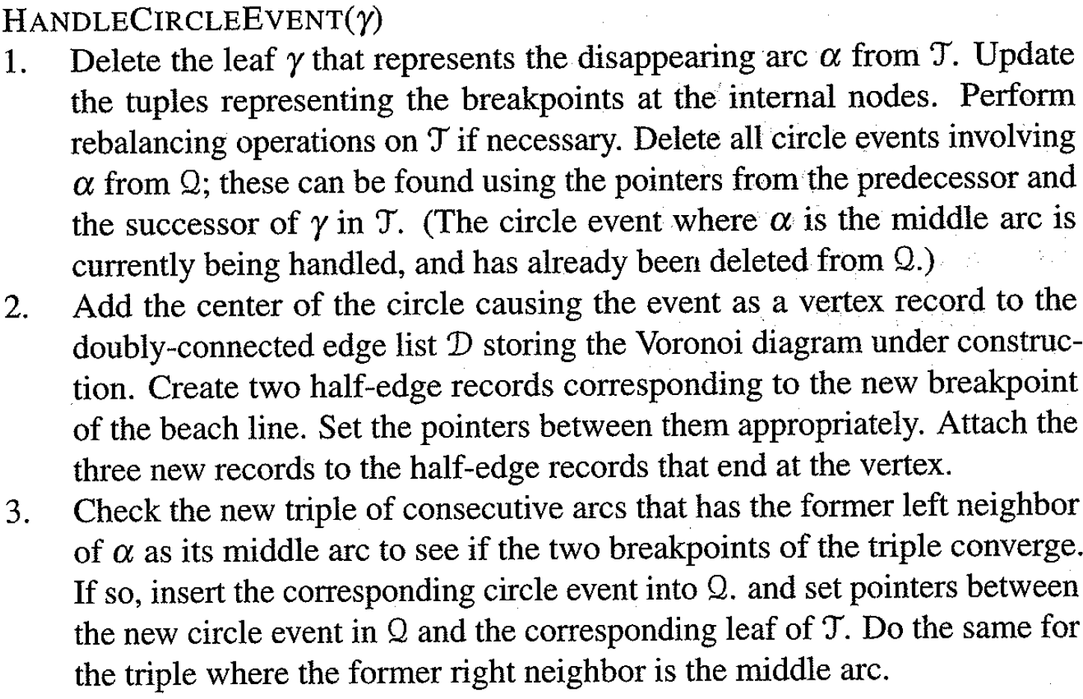

Slide 22
