Slide 1
Computer Science Day 2012 Friday May 25, 13:15-15:45, The Large Auditorium
New results and high lights presented by each research group
13.15-13.20 Welcome
13.20-13.25 The 'Lecturer of the Year' award
13.25-14.25 Session I
Algorithms and Data Structures
Data-Intensive Systems
Cryptography and Security
Ubiquitous Computing and Interaction
Computer-Mediated Activity
14.25-14.45 Coffee Break
14.45-15.45 Session II
Use, Design and Innovation
Bioinformatics
Programming Languages
Mathematical Computer Science
Computer Graphics and Image Processing
Closing Remarks
For everybody with an interest in computer science
cs.au.dk/csd2012

Slide 2
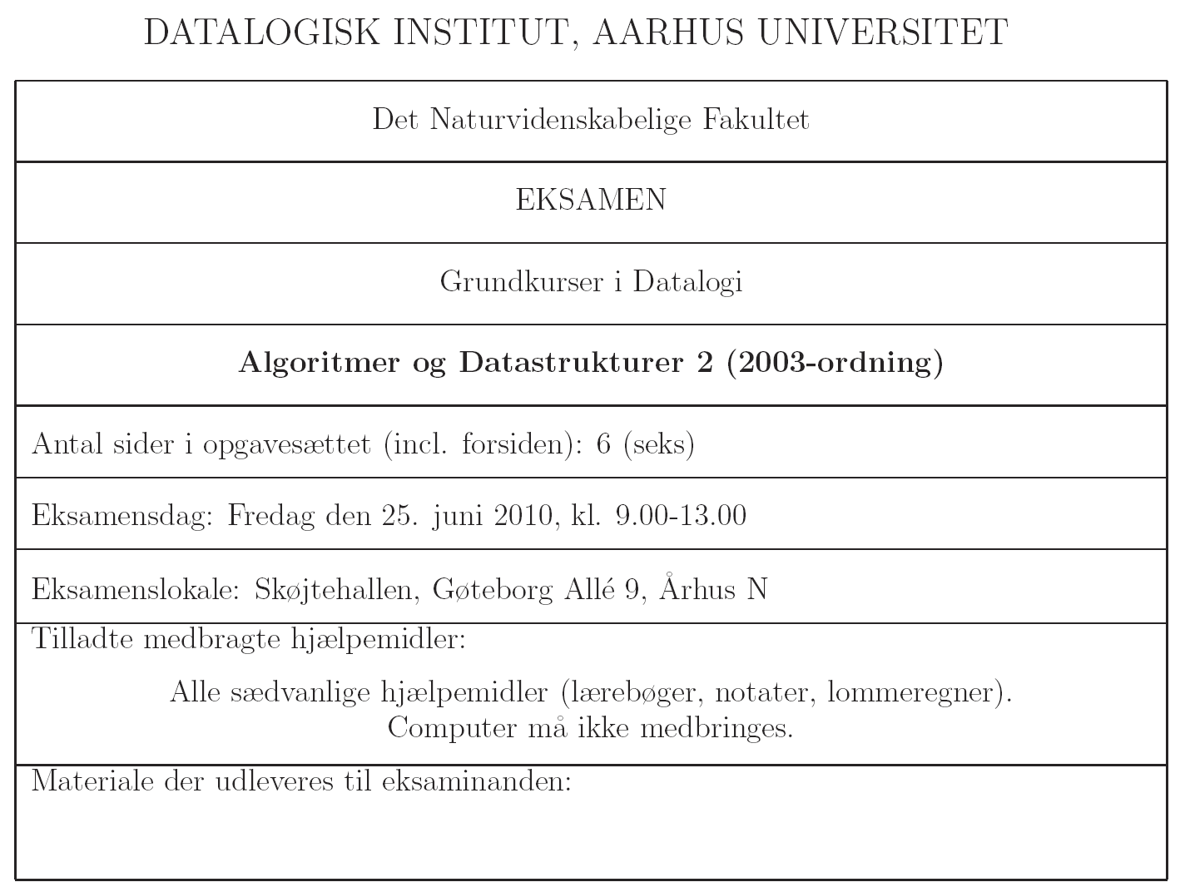

Slide 4
1(a) BFS

Slide 5
1(b) DFS

Slide 6
1(c) Korteste veje

Slide 7
1(d) Korteste veje

Slide 8
1(e) MST

Slide 10
2(a) Max-Flow

Slide 11
2(b) Edmonds-Karp

Slide 13
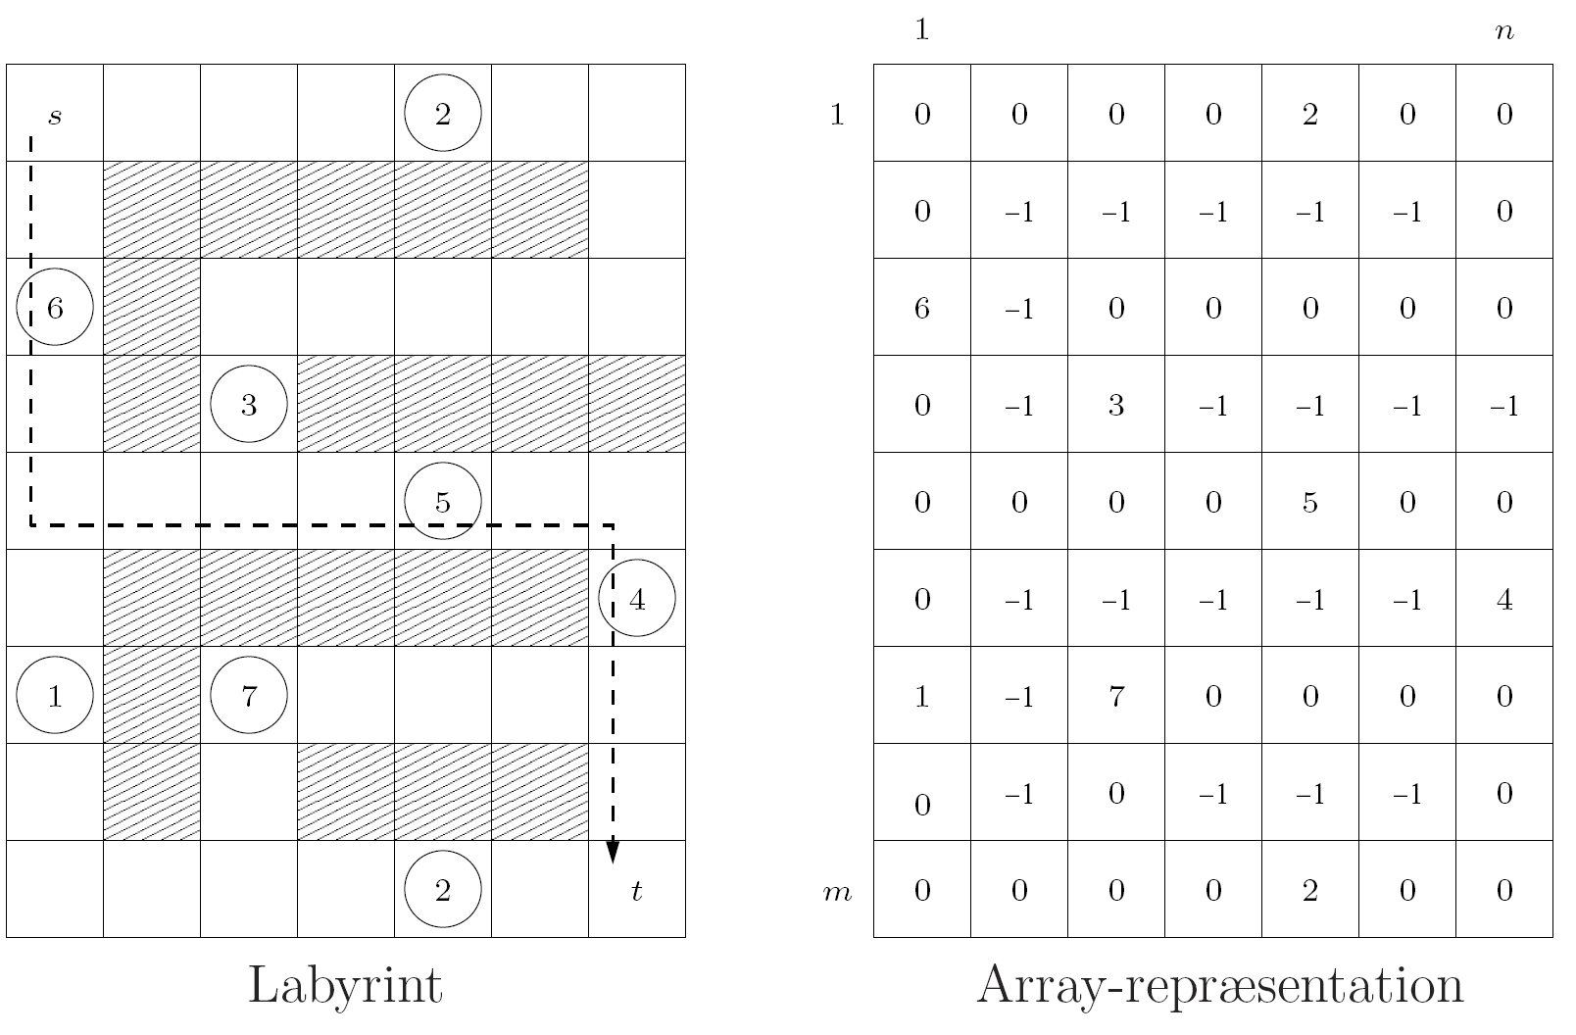

Slide 16
