Slide 1
Prioritetskøer med Afskæring
Rajamani Sundar, Worst-case data structures for the priority queue with attrition, Information Processing Letters, 31(2), 69-75, 1989.

Slide 2
Operationer
Create S := Ø
Insert(x) S := { x } ᴜ { y∈S | y < x }
Deletemin m := min(S); S := S \ { m }; return m

Slide 3
Løsning: Sorteret Liste
Create S := ()
Insert(x) while (|S|>0 and tail(S)≥x) remove_tail(S)
insert_tail(x)
Deletemin return remove_head(S)

Slide 4
Løsning: Sorteret Liste
Create S := ()
Insert(x) while (|S|>0 and tail(S)≥x) remove_tail(S)
insert_tail(x)
Deletemin return remove_head(S)
Sætning
Create, Insert og DeleteMin tager amortiseret O(1) tid
Bevis: Φ(S) = |S|. □

Slide 5
Worst-Case O(1)

Slide 6
Løsning: 4 Lister
Invarianter
C, B, D_{f} sorterede
max C ≤ min (B ᴜ D_{f} ᴜ D_{r})
|C|≥ |D_{f}|+2|D_{r}|
17 ≥ 4+2∙5
C
B
D_{f}
D_{r}
indsættelsestidspunkt

Slide 7
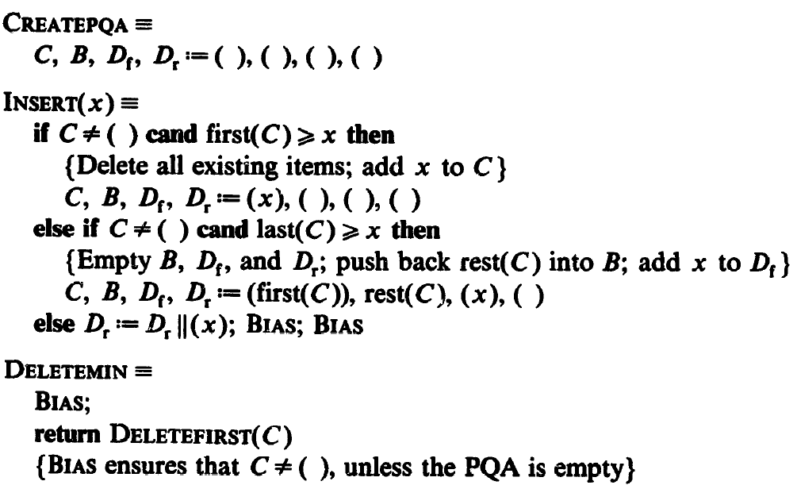
Invarianter
C, B, D_{f} sorterede
max C ≤ min (B ᴜ D_{f} ᴜ D_{r})
|C|≥ |D_{f}|+2|D_{r}|
1
≥ “+1”
Bias
2
3
3
2
1
C
B
D_{f}
D_{r}

Slide 8
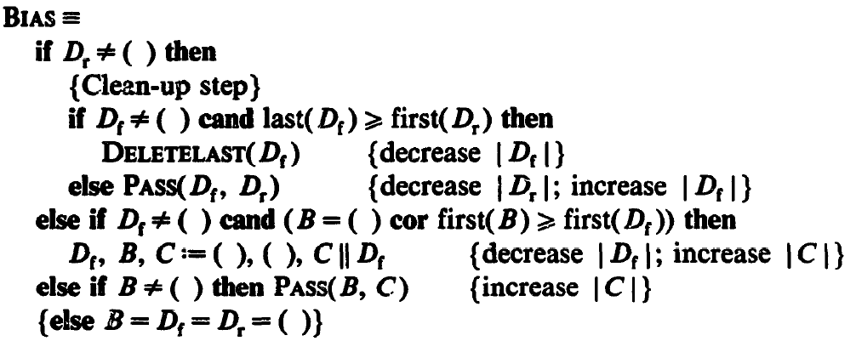
Invarianter
C, B, D_{f} sorterede
max C ≤ min (B ᴜ D_{f} ᴜ D_{r})
|C|≥ |D_{f}|+2|D_{r}|
≥ “+1”
Bias
A
B
C
D
A
B
C
D
D_{f} -1
D_{f} +1, D_{r} -1
C=C+D_{f}, B=D_{f}=0
C +1, B -1
D_{r}
C
B
D_{r}
C
B
D_{f}
D_{r}
C
B
D_{f}
D_{r}
C
B
D_{f}
D_{f}

Slide 9
Sætning
Create, Insert og DeleteMin tager worst-case O(1) tid
Invarianter
C, B, D_{f} sorterede
max C ≤ min (B ᴜ D_{f} ᴜ D_{r})
|C|≥ |D_{f}|+2|D_{r}|
C
B
D_{f}
D_{r}

Slide 10
Åben problem
Create, Insert, DeleteMin og Concatenate i worst-case O(1) tid
Concatenate(S₁, S₂) S := { y∈S₁ | y < min(S₂) } ᴜ S₂
S₁
S₂

